Slide 1



NEXTCITY: A SMART CITY MANAGEMENT SYSTEM
Course: Database Management Systems
Team NeonGrid
Strategic Thinking for Maximum Impact

Slide 2



Introduction
What is NextCity?
NextCity is a smart city management system designed to enhance city management by integrating key services into a unified platform. Features include healthcare services, feedback mechanisms, and issue tracking.
4

Slide 3

Main Features
User Management with role-based access control.
Advanced search features for locations and services.
Feedback Mechanism for continuous improvement.
Issue Tracking for reporting and monitoring issues.
.
Healthcare features including doctor-patient management.

Slide 4
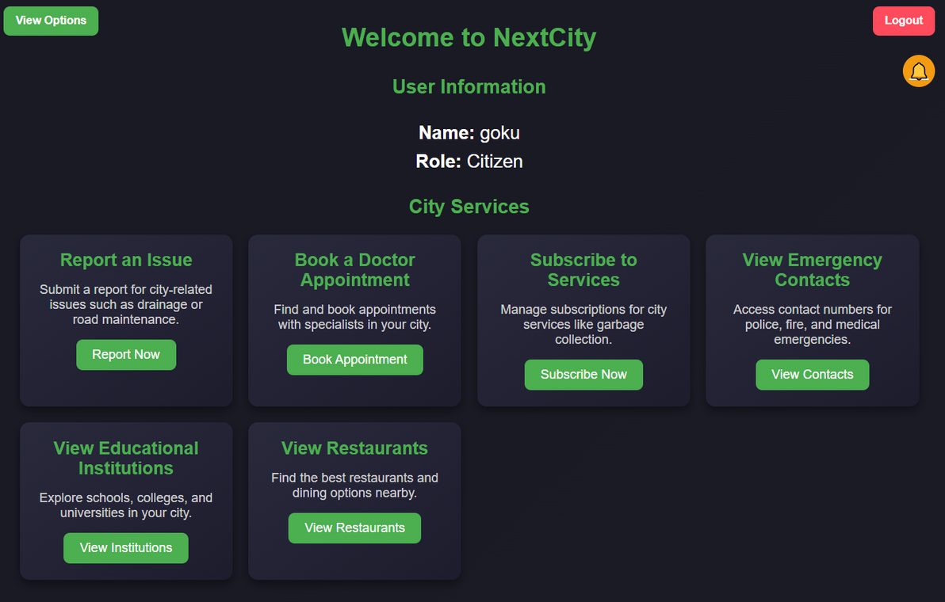
Citizen
Features
User Management:
Issue Tracking:
Role-based access control
(citizens, admins, doctors).
Report issues, track status, and assign to departments.
Address and Location Services:
Search Features:
Link addresses to wards, streets, and buildings.
Locate educational institutions, shops, and restaurants.
City Services:
Subscription-based services with detailed descriptions
Notification System:
Receive notifications from administrators
Feedback Mechanism:
Provide categorized feedback and ratings.

Slide 5
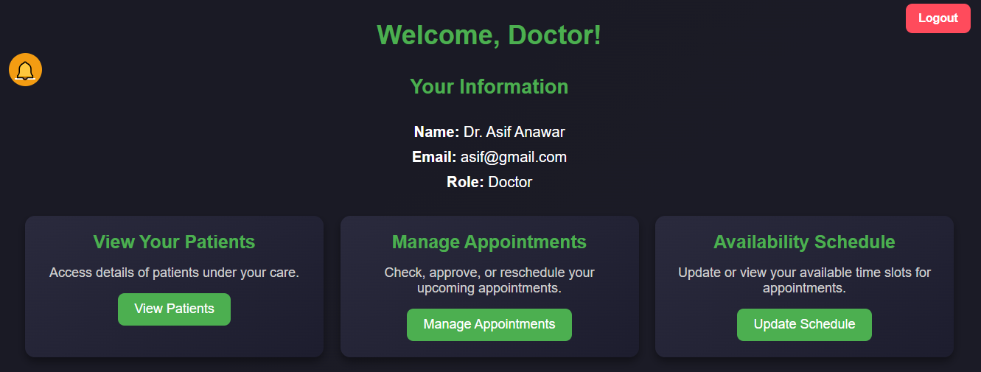
Doctor Features
. Manage appointments and schedules.
View patient details.
View ailments,.
View prescriptions,.

Slide 6
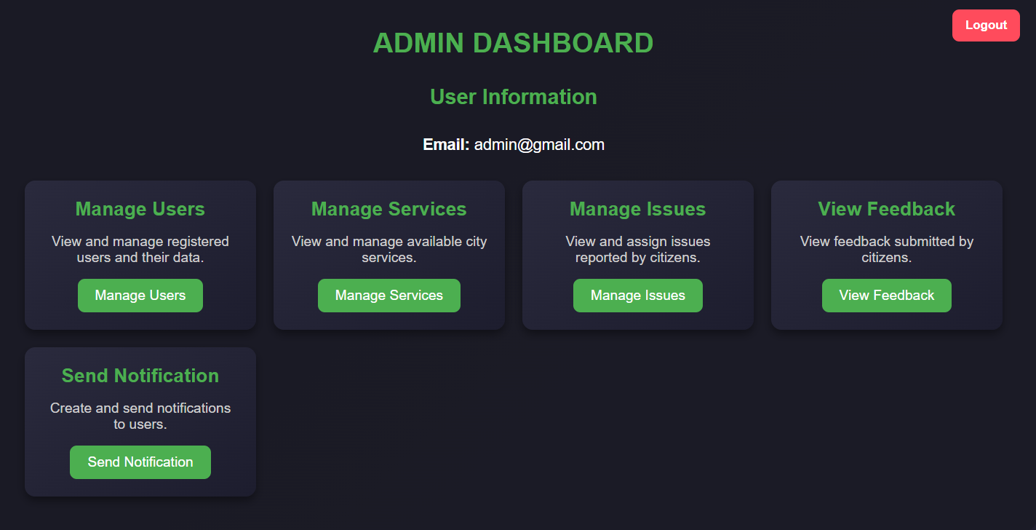
Admin Features
Manage users and assign roles.
Add and update city services.
Monitor and resolve reported issues.
Send notifications to citizens.
View analytics and feedback reports.
View and add institutions and restaurants.

Slide 7
Why Choose NextCity?
Comprehensive and user-friendly design.
Real-time notifications and advanced search.
Prepared for future enhancements with AI and mobile apps.

Slide 8
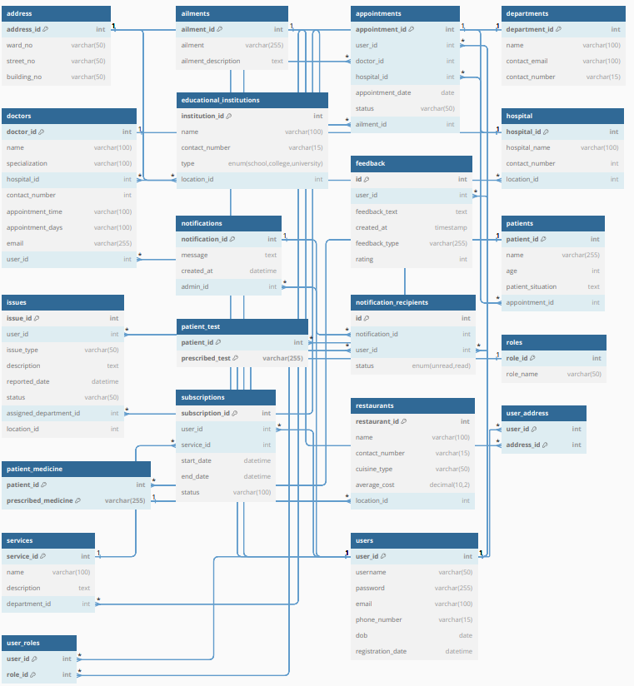
Schema Diagram

Slide 9
Future Work
AI-based predictive analytics.
Mobile app integration.
Enhanced feedback analysis.

Slide 10
Conclusion
NextCity surpasses similar systems like SmartCityOS by offering a more comprehensive, user-friendly, and future-proof solution. It not only meets current needs but is also prepared for futureurban challenges. NextCity is the smarter choice for smart city management!

